Slide 1
Geospatio-Temporal Data Management and Visualization with PostGIS, QGIS and Python
Dr. Rolf Becker
Clein Sarmiento
Rhine-Waal University of Applied Sciences

Slide 2

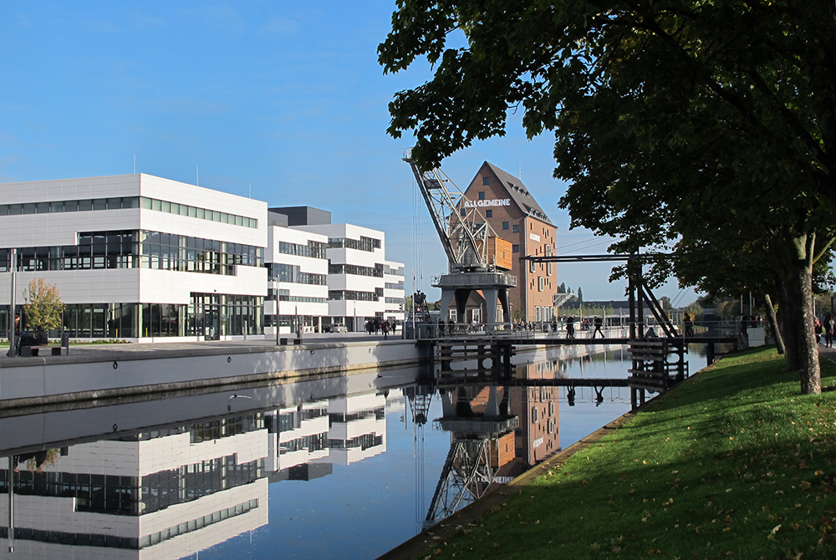
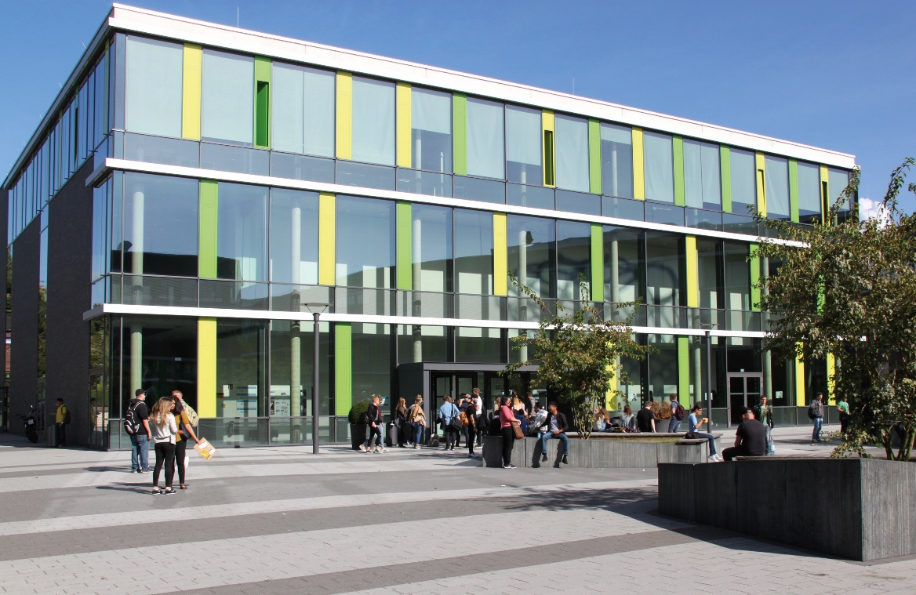
HSRW – Two Campuses
Campus Kleve
Campus Kamp-Lintfort
www.hsrw.eu

Slide 3
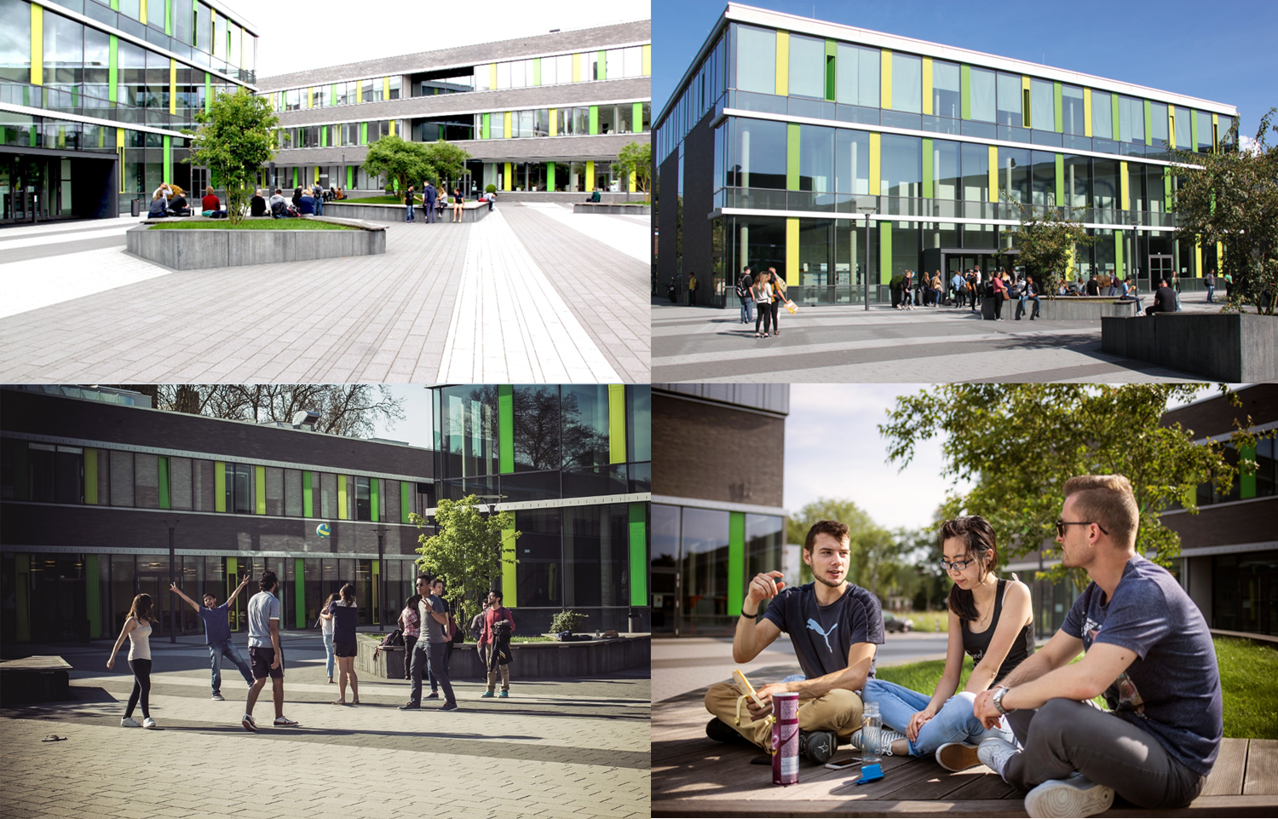
Rhine-Waal University of Applied Sciences (hsrw.eu)
Campus Kamp-Lintfort

Slide 4
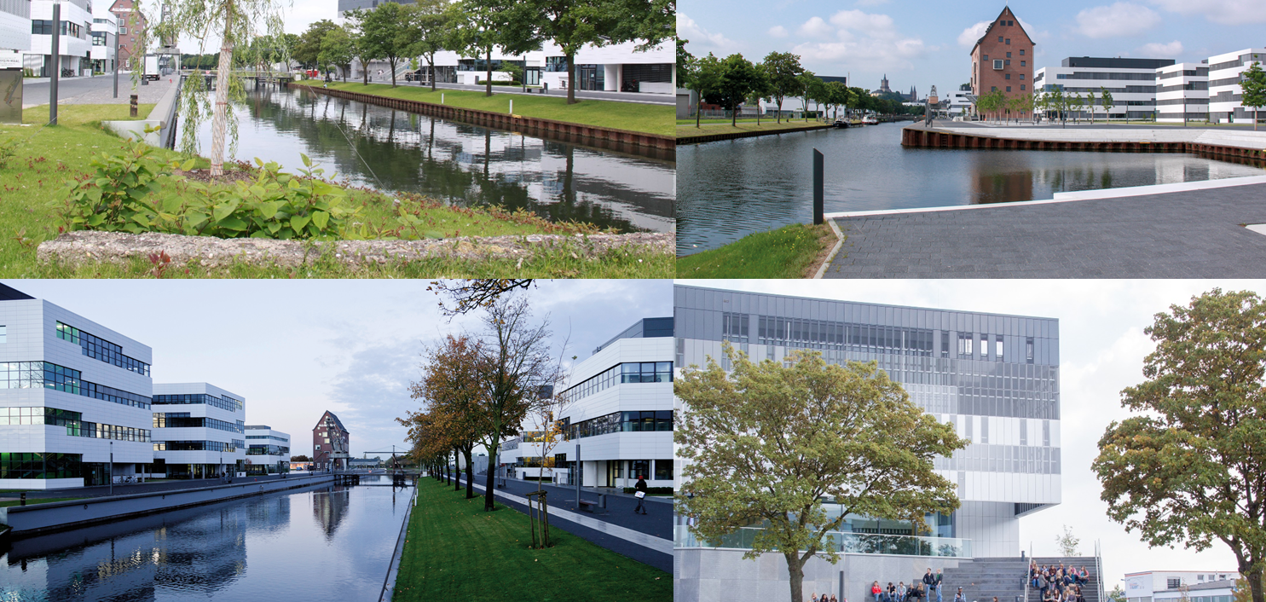
Rhine-Waal University of Applied Sciences (hsrw.eu)
Campus KLEVE

Slide 5
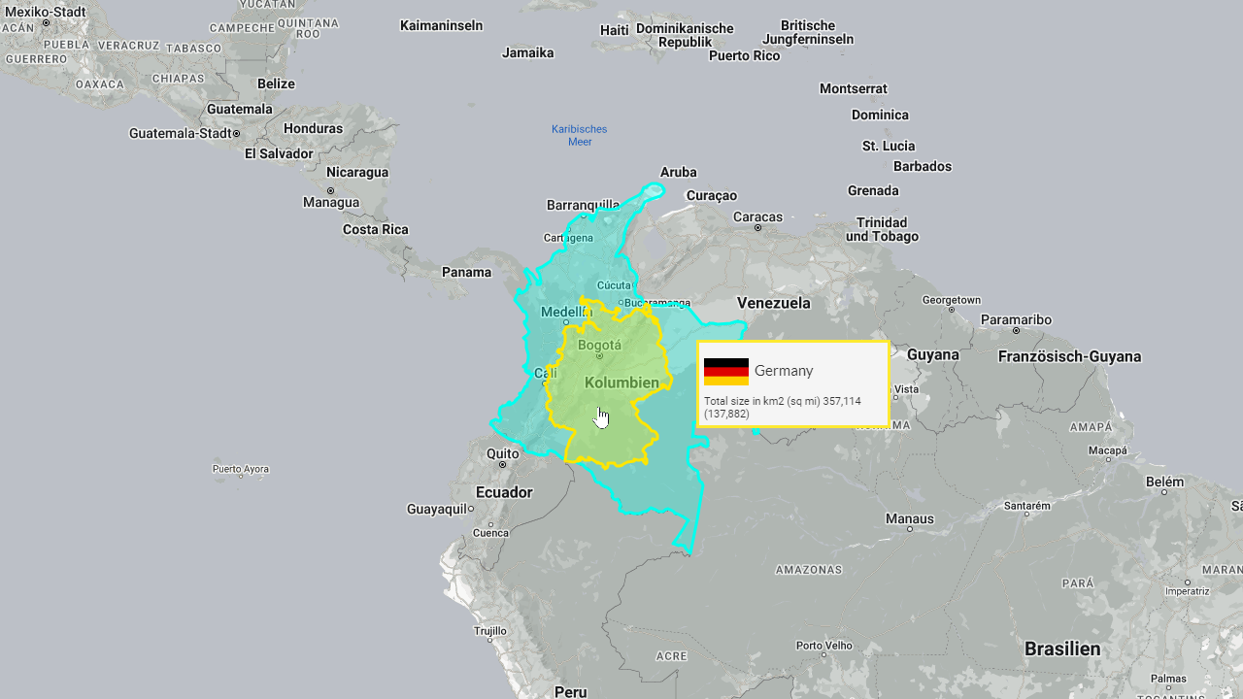
https://www.thetruesize.com/

Slide 6
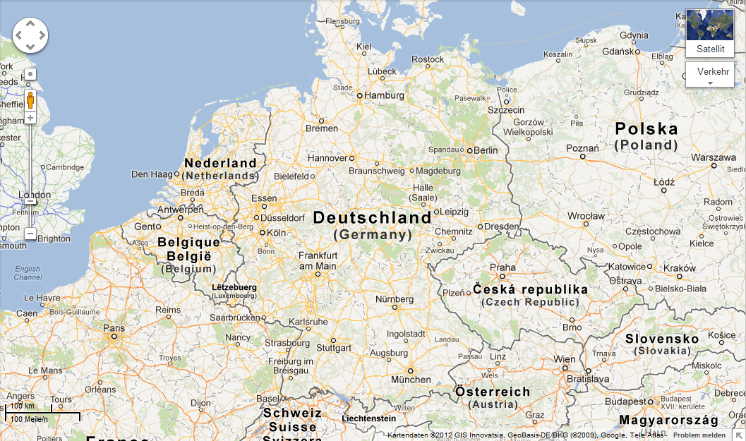
Lower Rhine Region, close to the Netherlands
Berlin
Cologne
NRW
Munich
Bavaria

Slide 7
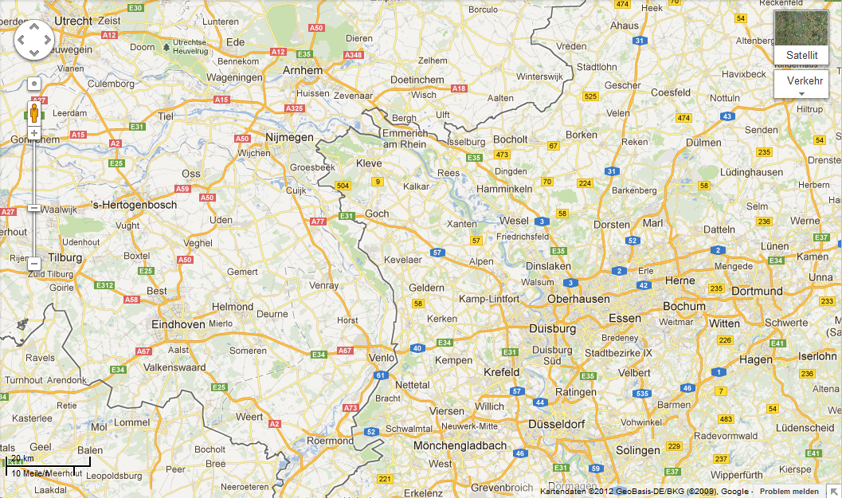

North Sea
DE
NL
Cologne

Slide 8
HSRW Facts
Public University -> no tuition fee
7000 Students
113 Professors
4 Faculties
> 50% Foreign Students
75% of Programmes in English
Education (undergrad., grad. and schools)
R&D
Transfer

Slide 9
Collaboration Opportunities with Companies
Internship in the company (6th semester, 20 weeks full-time)
Final thesis in the company (approx. 3 months of official work)
Bachelor
Master
Interdisciplinary student projects (5th semester, 200 h per student)
General student projects: external topics set in lectures
Joint R&D projects (e.g. via HSRW transfer office ZFIT)
Publicly funded
Privately funded: Contract R&D

Slide 10

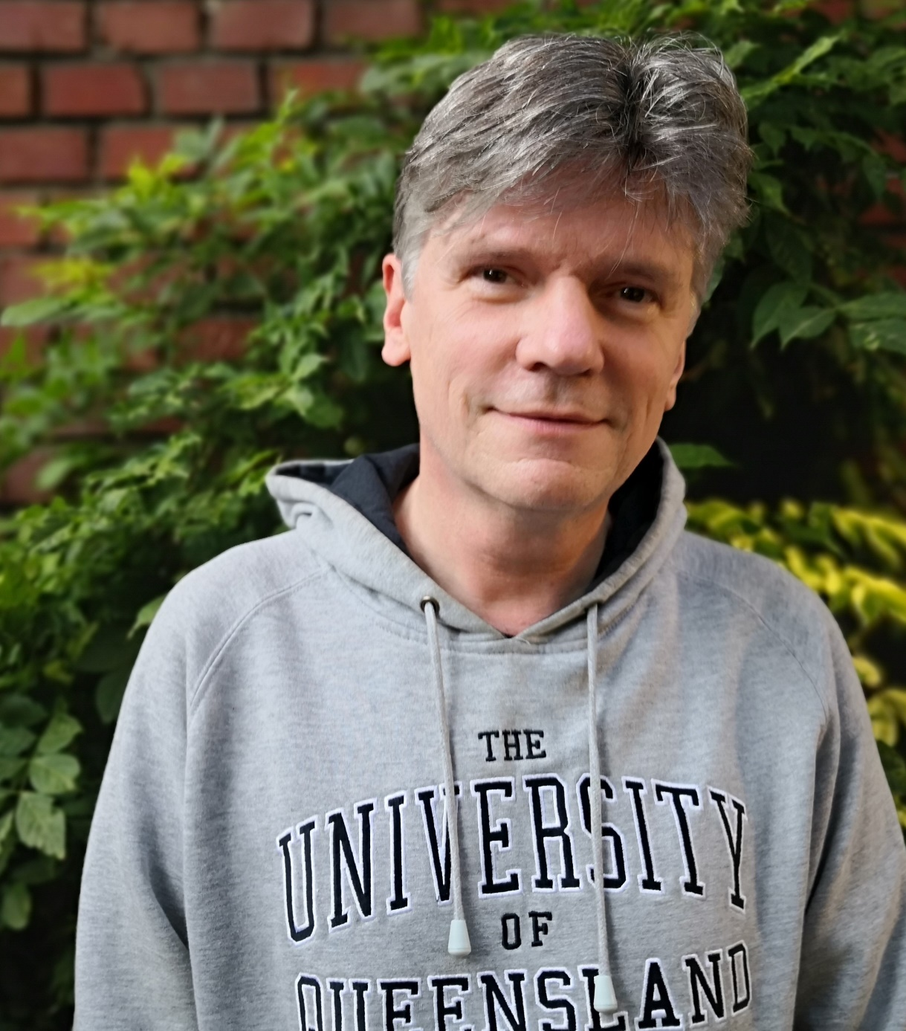
Dr.-Ing. Rolf Becker
Professor for Physics at HSRW (since 2010) Earth Observation Lab, IoT Lab, Drone Lab
Adjunct Professor at the University of Queensland
Member of European Assoc. of Remote Sens. Labs
R&D interests: Environmental monitoring systems, IoT, remote sensing with drones, machine learning, computer vision, AI at schools, educ. for sust. development (UN SDG)
> 10 funded projects at HSRW, > 5 Mio € fundable costs
Head of the DAAD cooperation project LatiNet
Head of development for env. monitoring systems at IMKO GmbH (2005 – 2009)
PhD at Karlsruhe Inst. of Tech. (Hydrology and Electr. Eng.) Thesis: development of a novel profiling soil moisture probe

Slide 11
Teaching / Applied Research – FOSS
Environmental Physics
Electrical Engineering
Scientific Programming / Data Engineering with Python
Geospatio-Temporal Data Management
Environmental Monitoring Systems (DIY), Electronics
Drones

Slide 12

Our Team is responsible for three HSRW Labs
Earth Observation Lab
RS with drones, environmental monitoring, installed own compute cluster (Kubernetes, OpenDroneMap, etc.)
Drone Lab
Development of utility drones, drones for education, SLAM, AI
IoT Lab
Development of sensor systems, from sensors via spatio-temporal databases to dashboards
www.eolab.de

Slide 13
Studienverlauf Bachelor (Vollzeit)
SEMESTER 1
SEMESTER 2
SEMESTER 3
SEMESTER 4 + 5
Grundlagenmodule
Weiterführende Module
Wahlmodule
SEMESTER 6
Praktikum oder Auslandsstudiensemester (20 Wochen)
SEMESTER 7
Bachelorarbeit (auch in Kooperation mit einem Unternehmen oder einer öffentlichen Einrichtung [3 Monate]) + Kolloquium

Slide 14
Studienverlauf Master
SEMESTER 1
SEMESTER 2
SEMESTER 3
Weiterführende Module
Masterarbeit
(auch in Kooperation mit einem Unternehmen oder einer öffentlichen Einrichtung
[4 Monate])
+
Kolloquium
Wahlmodule

Slide 15
Schnittstellen zu Unternehmen
Praktikum im Unternehmen (6. Semester, 20 Wochen Vollzeit)
Abschlussarbeiten im Unternehmen (ca. 3 Monate offizielle Bearbeitung)
Bachelor
Master
Interdisziplinäre Studi-Projekte (5. Semester, 200 h pro Student:in)
Studierenden-Projekte: externe Themen in Vorlesungen setzen
Gemeinsame F&E-Projekte (z.B. über HSRW-Transfer-Stelle ZFIT)
Öffentlich gefördert
Privat finanziert: Auftrags-F&E

Slide 16
DAAD

Slide 17
The True Size Of …

Slide 19
The Team: Mission and Vision
EO Lab, IoT Lab, Drone Lab, Green Fab Lab
Mission / Vision
3rd Mission
Technology for the common good

Slide 21
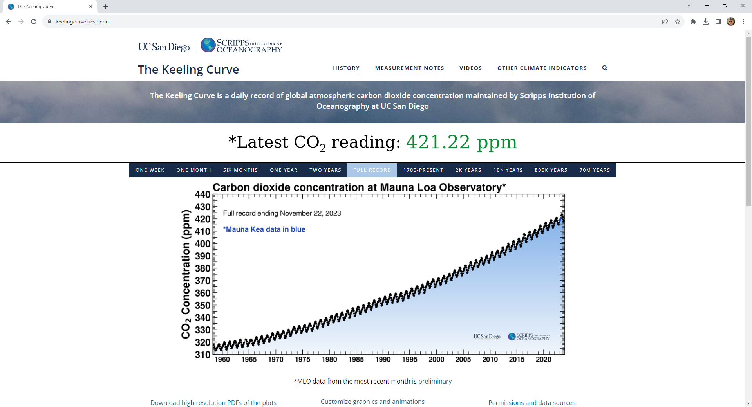
https://keelingcurve.ucsd.edu/

Slide 22
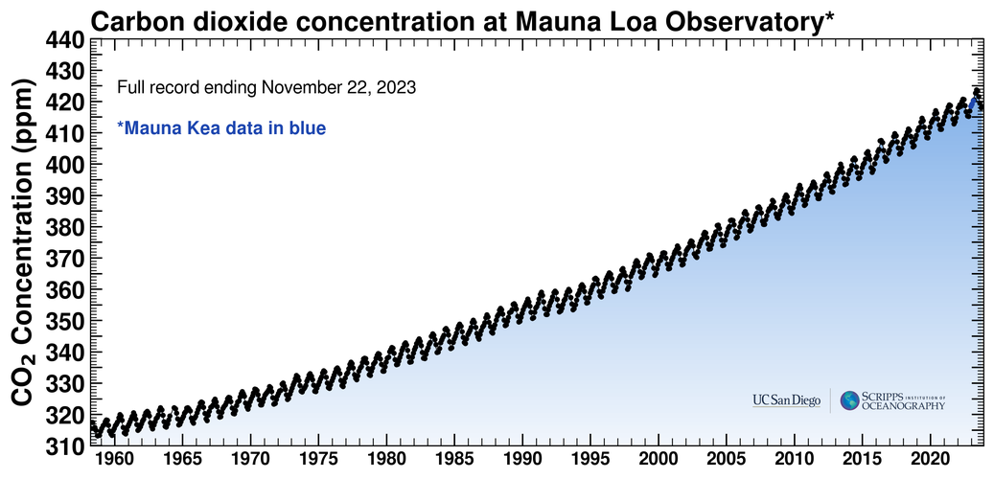
Keeling Curve
https://keelingcurve.ucsd.edu/

Slide 23
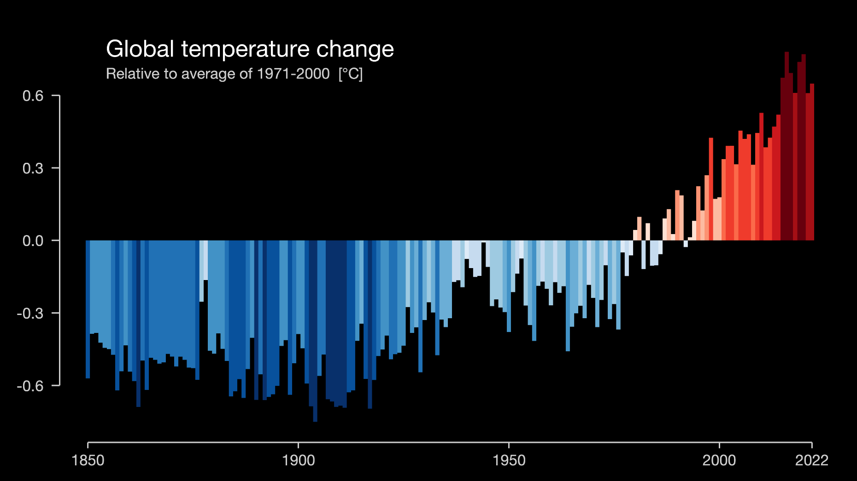
https://showyourstripes.info/
Ed Hawkins, University of Reading

Slide 24
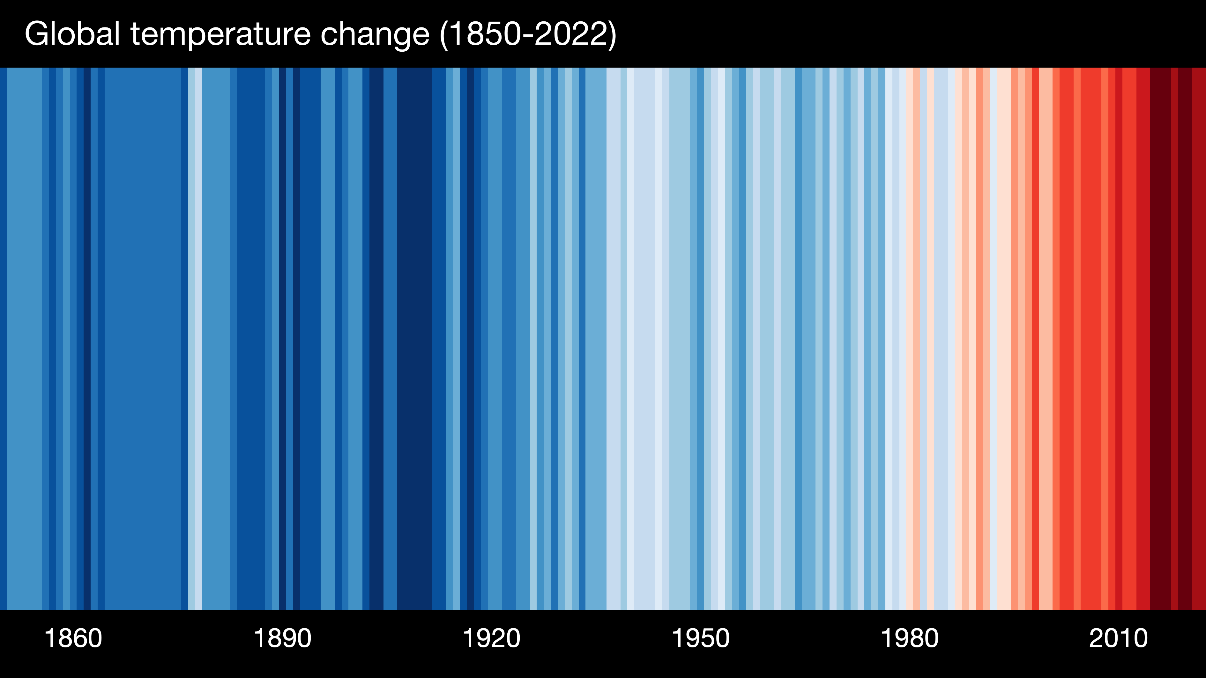
Warming Stripes
Ed Hawkins, University of Reading
https://showyourstripes.info/

Slide 25
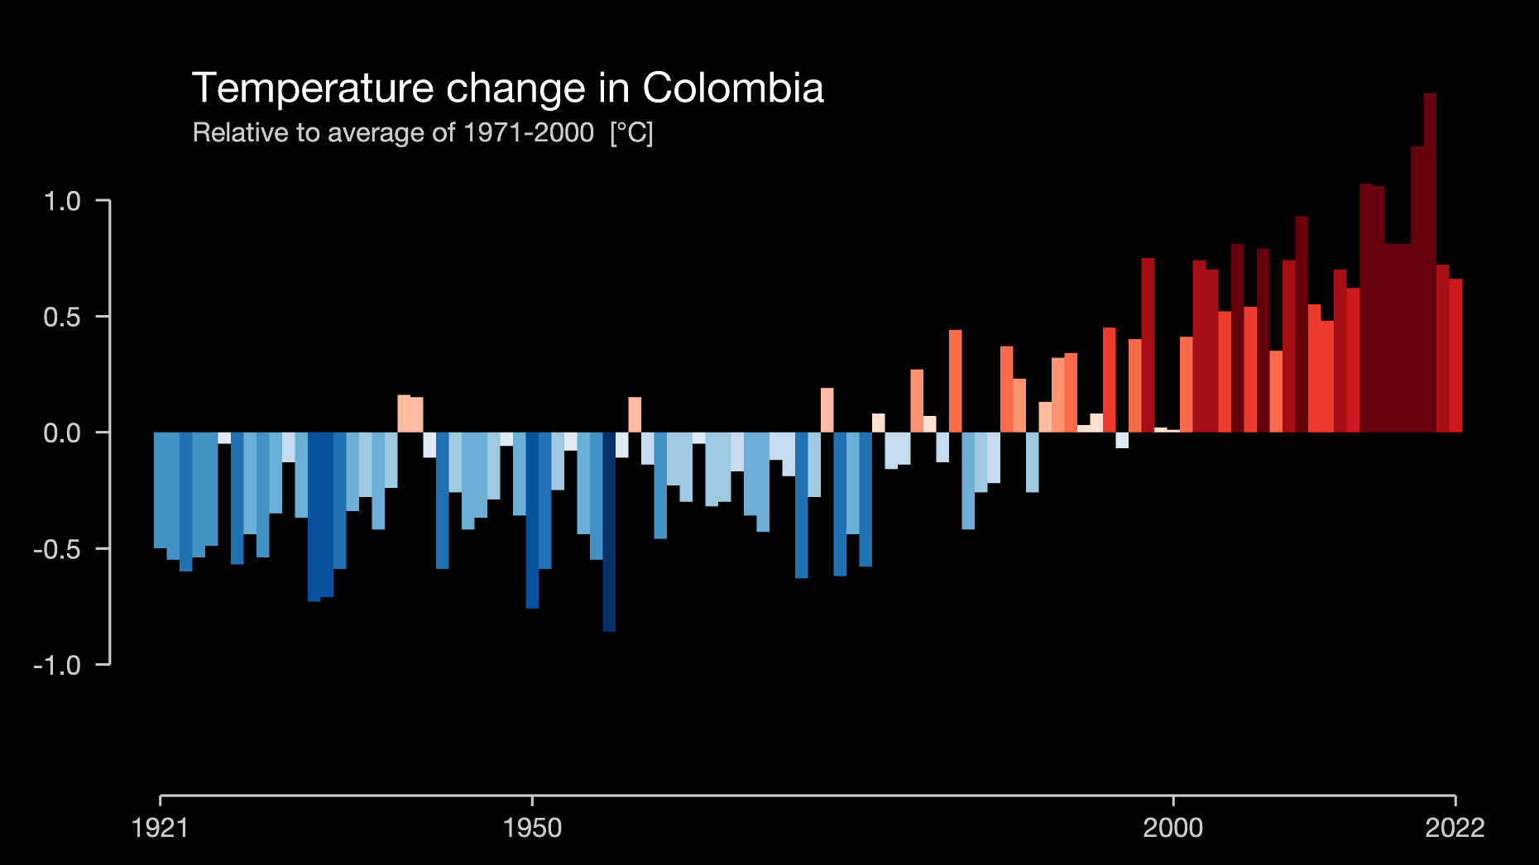
https://showyourstripes.info/
Ed Hawkins, University of Reading

Slide 26
NASA: Climate Change
Tipping points

Slide 27
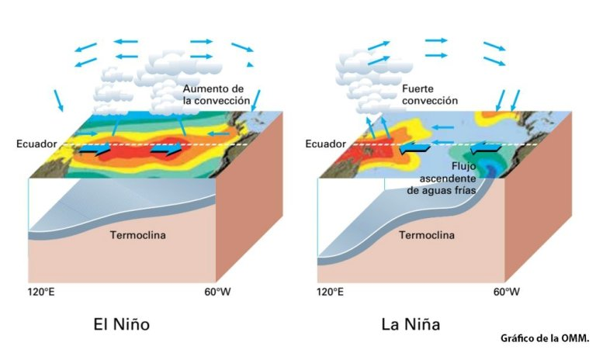
El Niño
https://x.com/AEMET_Esp/status/1667039918042886147?s=20
Source: AEMET.es

Slide 28
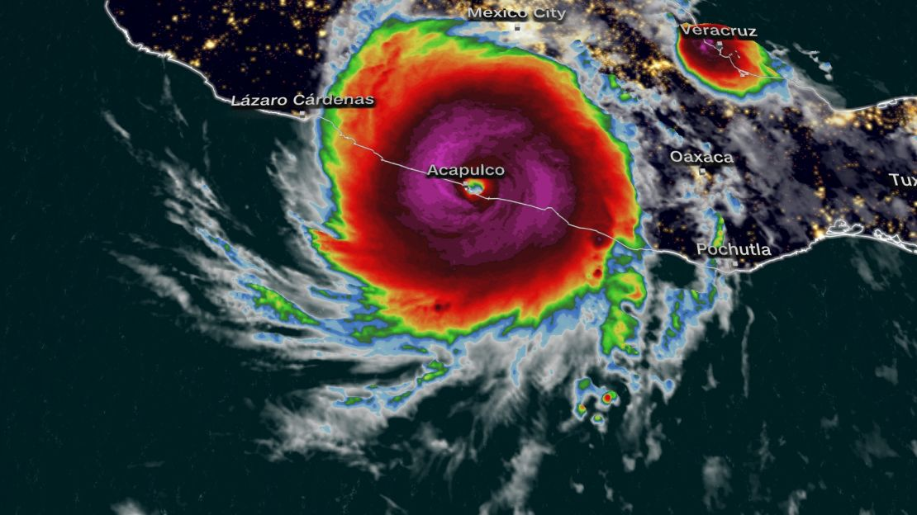

https://edition.cnn.com/2023/10/24/weather/hurricane-otis-acapulco-mexico/index.html

Slide 29
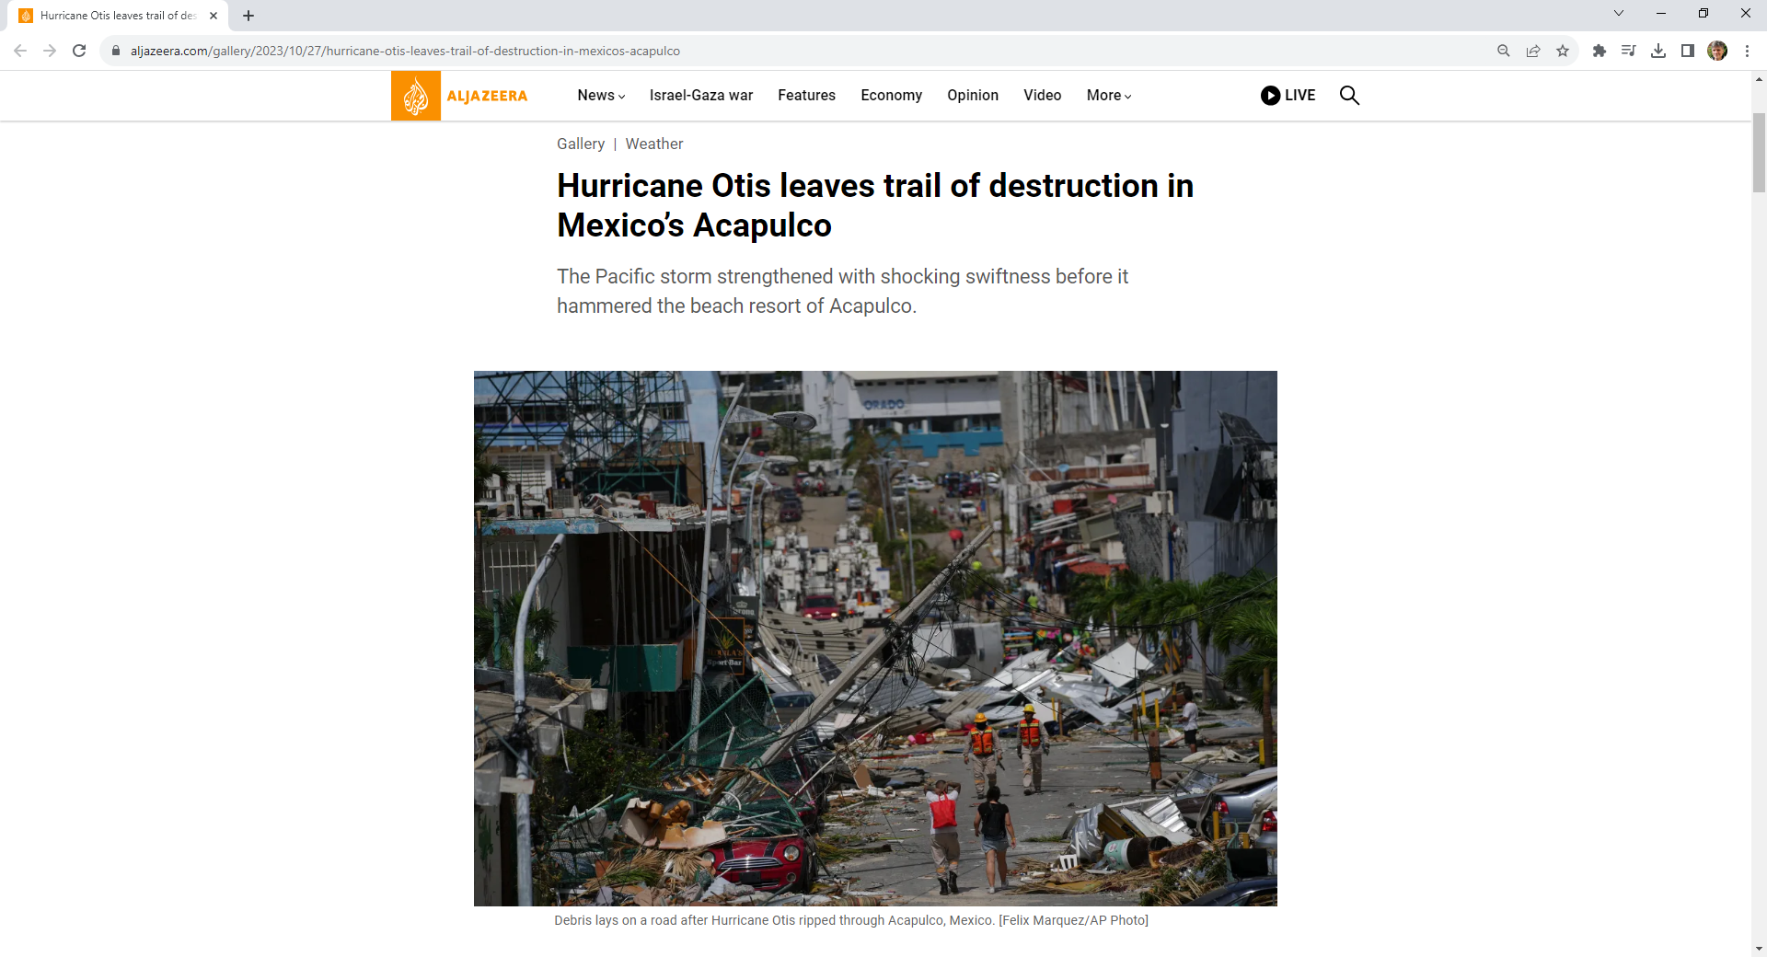
https://www.aljazeera.com/gallery/2023/10/27/hurricane-otis-leaves-trail-of-destruction-in-mexicos-acapulco

Slide 30

https://www.nature.com/immersive/d41586-023-02599-1/index.html

Slide 31
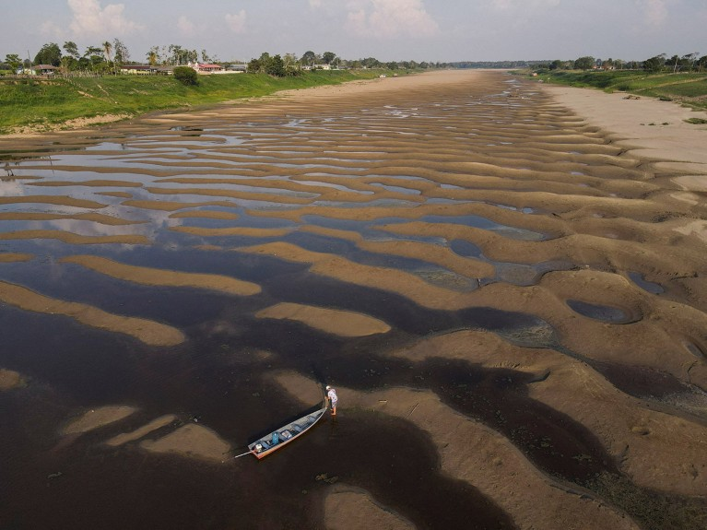

https://www.nature.com/articles/d41586-023-03469-6#:~:text=The%20rainforest%20has%20experienced%20dry,Ni%C3%B1o%20is%20just%20getting%20started.
Nature, 2023-11-14

Slide 32
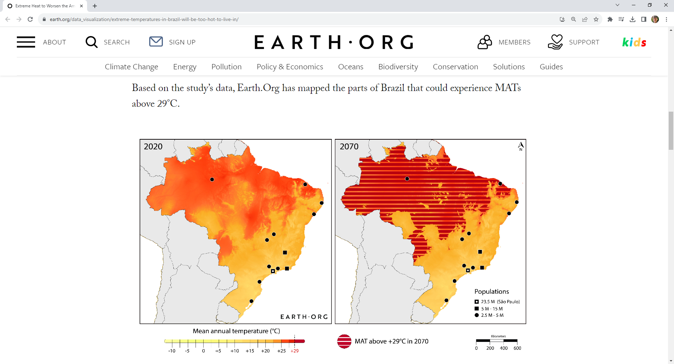
https://earth.org/data_visualization/extreme-temperatures-in-brazil-will-be-too-hot-to-live-in/

Slide 33
https://showyourstripes.info/
Ed Hawkins, University of Reading

Slide 34
Ed Hawkins: Warming Stripes

